Slide 1
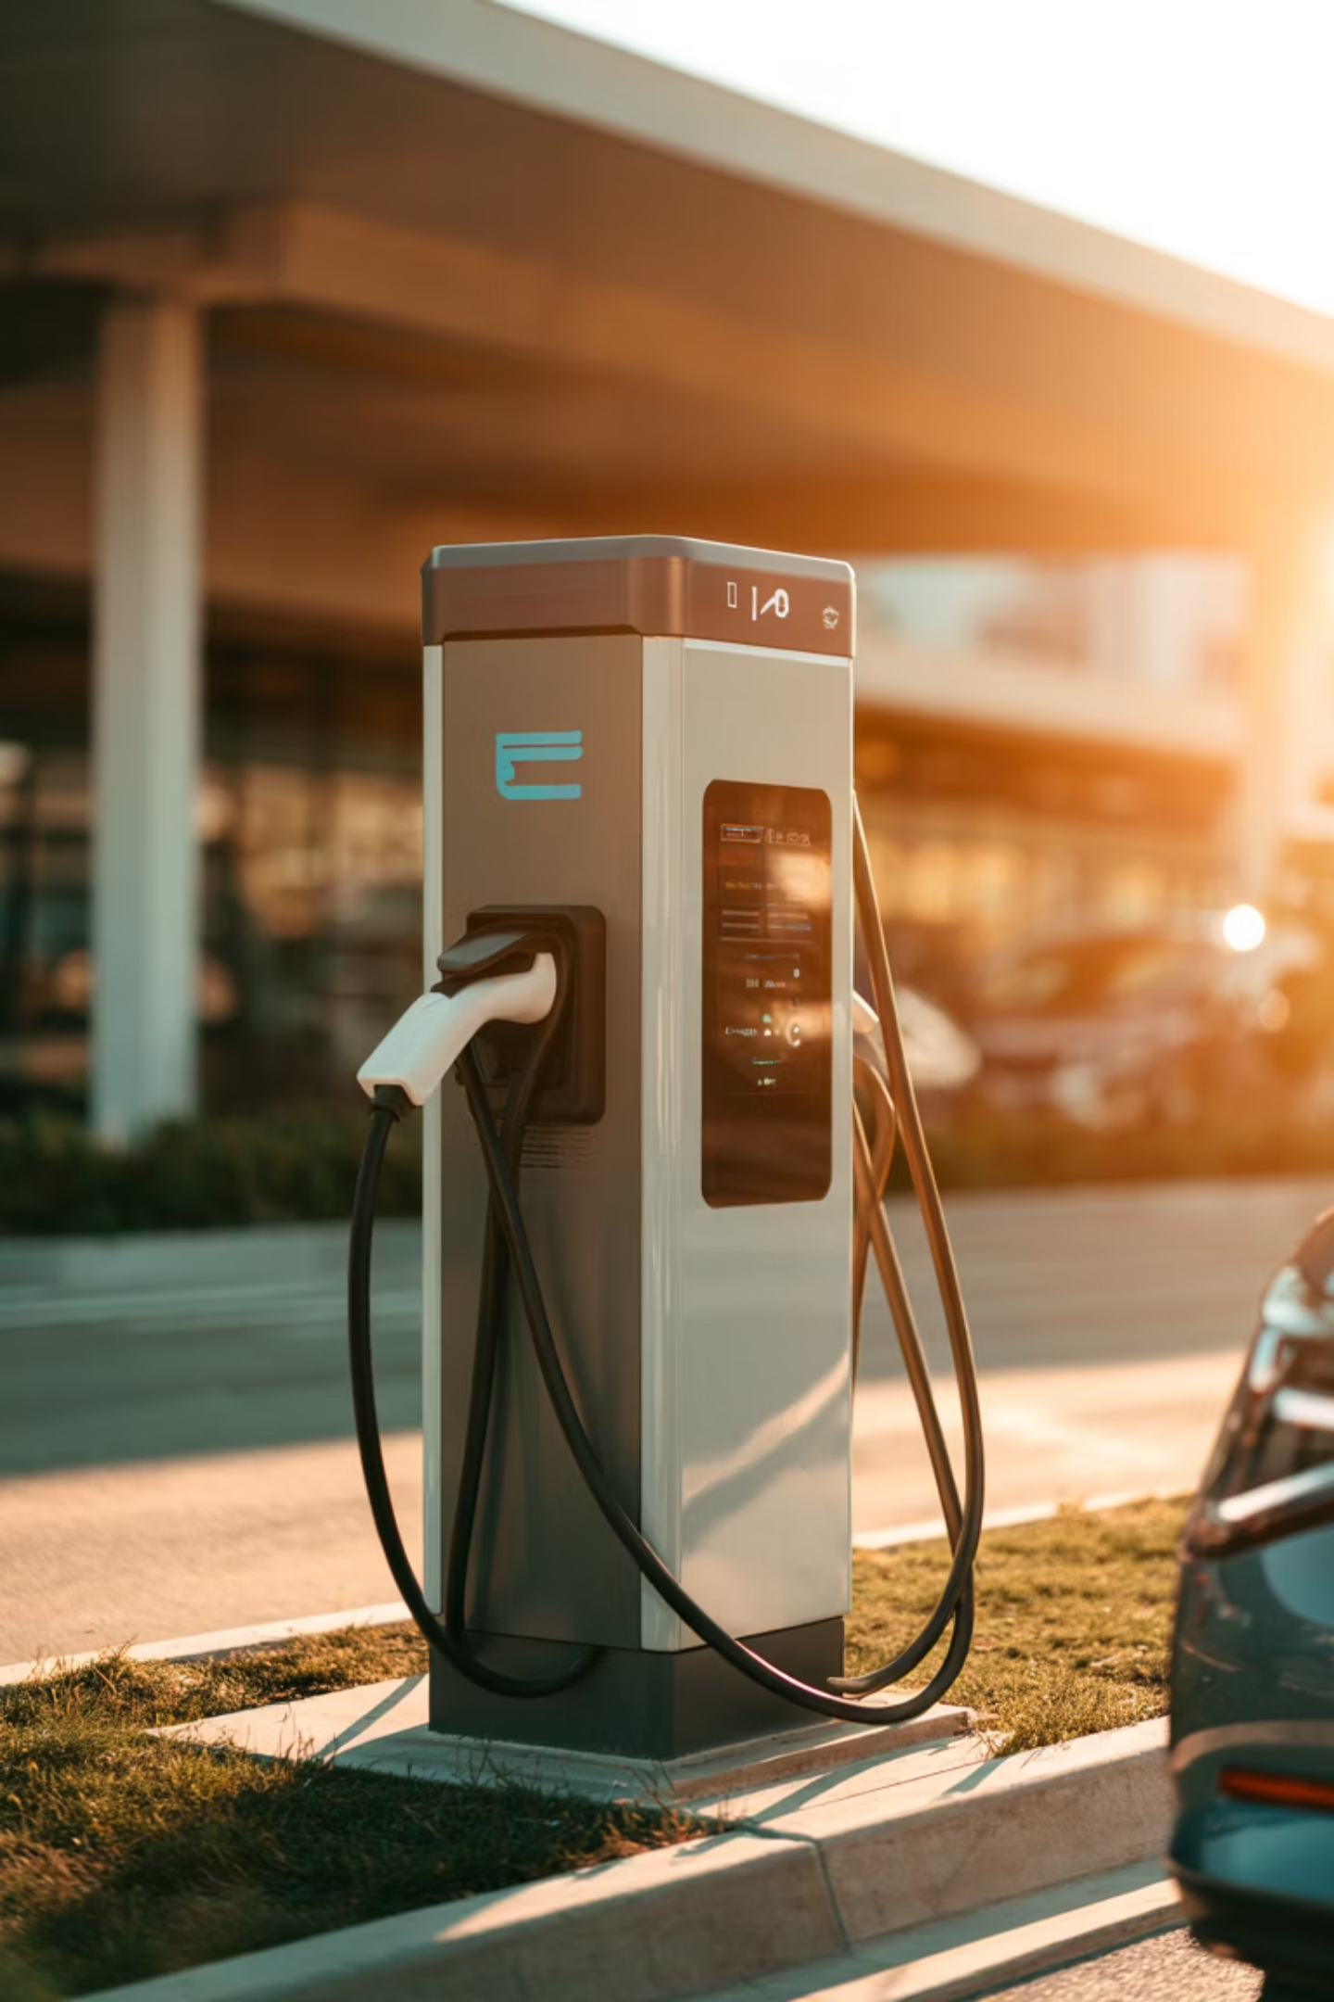
Charging Infrastructure for Electric Vehicles
Challenges and AI-Based Solutions
Fulpagare Pradnyesh 1272250462@mitwpu.edu.in
Department of Computer Science and Application MIT World Peace University Pune, Maharashtra.1
Nangare Ishaa 1272250455@mitwpu.edu.in
Department of Computer Science and Application MIT World Peace University Pune, Maharashtra.

Slide 2
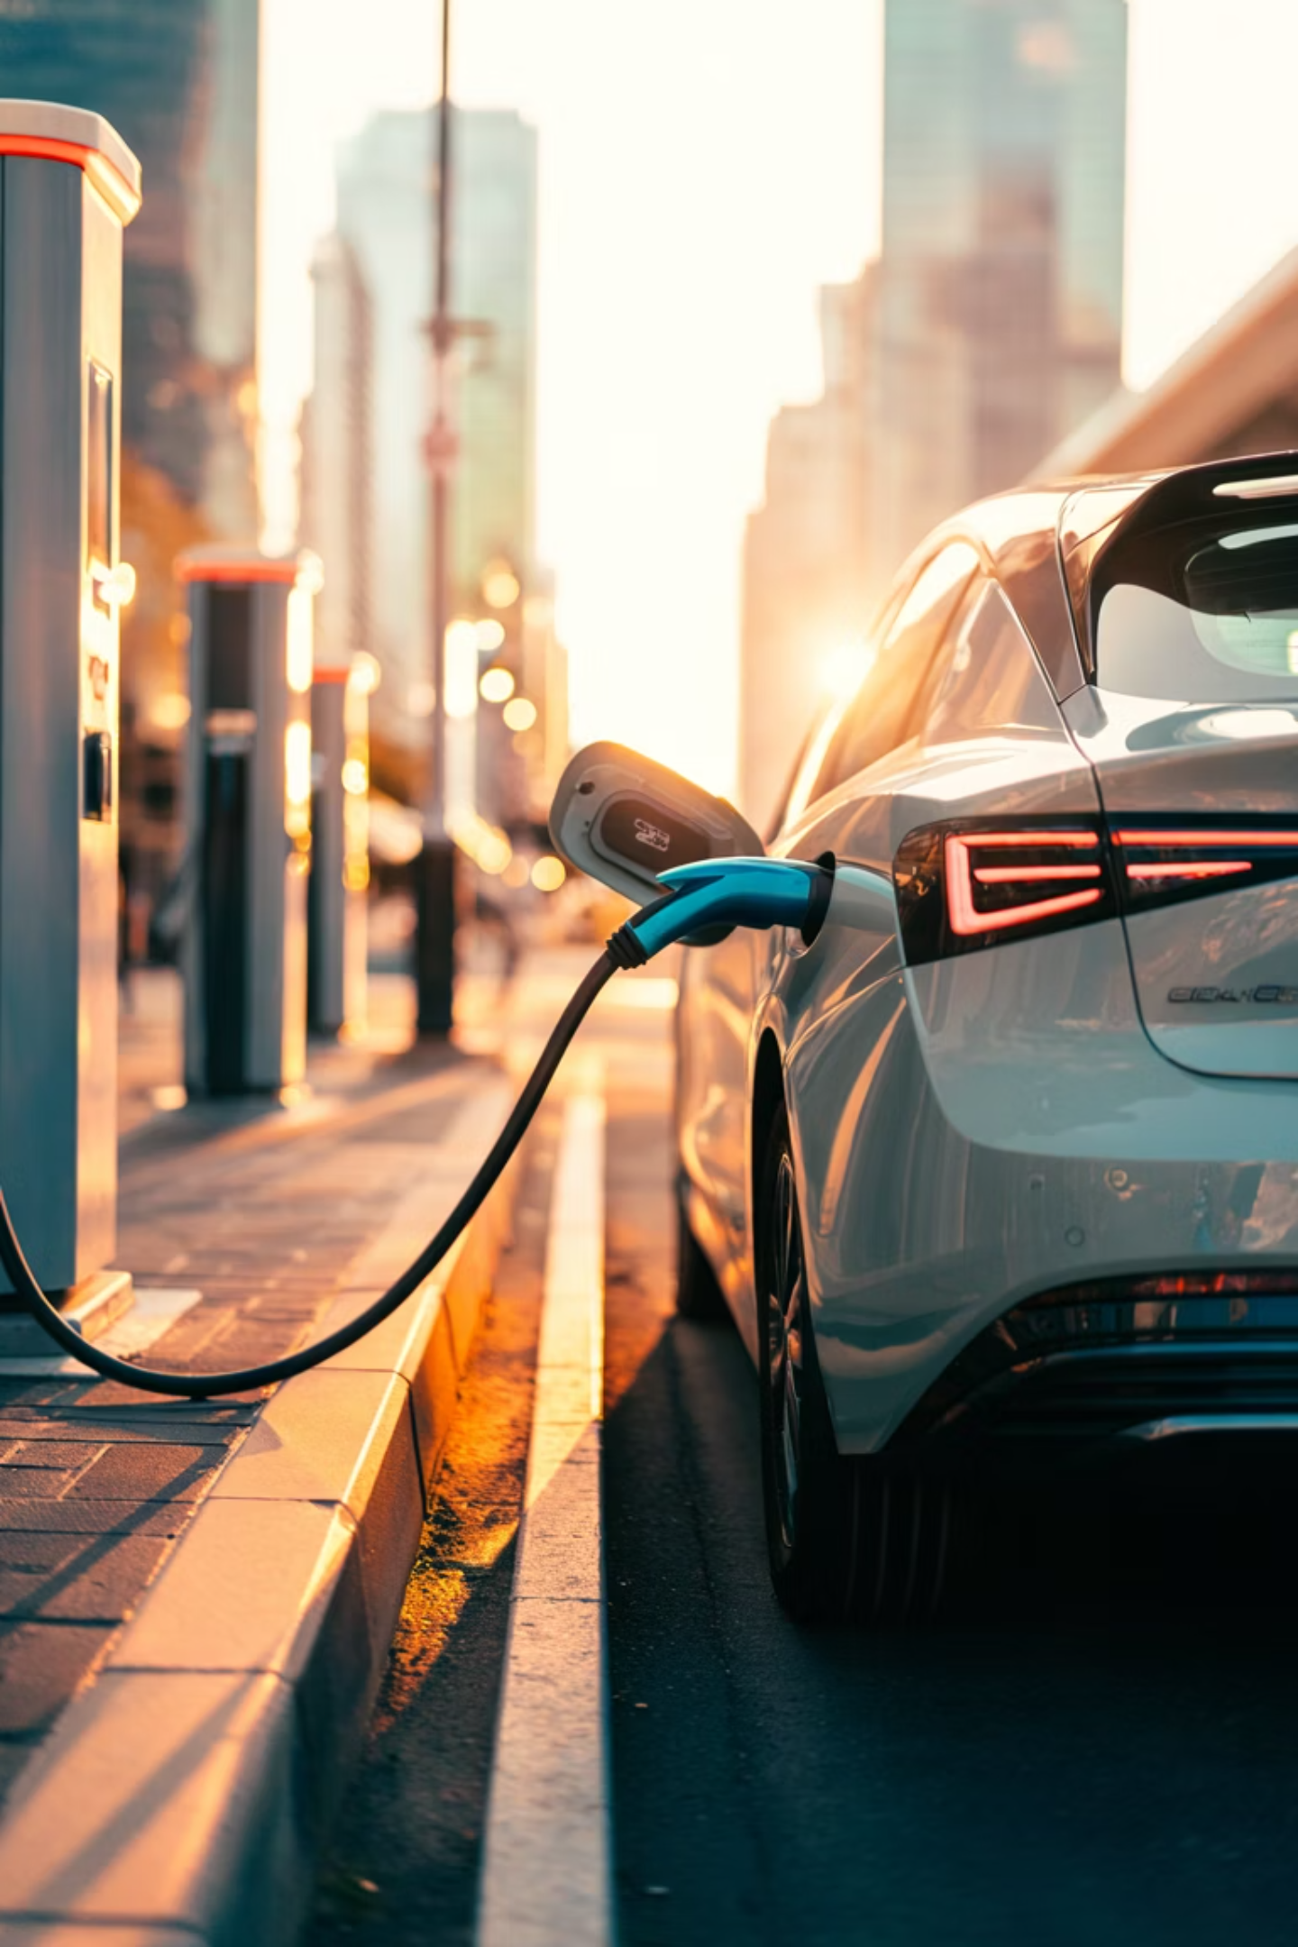

Introduction
Electric vehicles (EVs) are the future of transportation, but their success depends on reliable charging infrastructure. Currently, charging stations face issues like long wait times, uneven distribution, and maintenance problems.
Artificial Intelligence (AI) can help solve these problems by predicting demand, optimizing charging schedules, and preventing equipment failures.
"EVs need charging stations everywhere. Without good infrastructure, people won't switch to electric cars. AI can make charging stations smarter and more efficient."

Slide 3
Problem Statement
Long Wait Times
Uneven Distribution
Too many cars at popular stations during peak hours
Some stations empty while others overcrowded
Equipment Failures
High Costs
Broken chargers cause inconvenience and lost revenue
Expensive installation and maintenance of infrastructure
"The main problems are simple: too many cars at some stations, too few at others, broken equipment, and high costs. These issues frustrate users and slow EV adoption."

Slide 4
Research Objectives
01
02
Predict Charging Demand
Optimize Charging
Use AI to forecast when and where cars will need charging
Smart scheduling to reduce wait times and balance load
03
04
Prevent Failures
Improve Efficiency
Predict maintenance needs before equipment breaks down
Make the whole charging network work better and cheaper
"My research has four clear goals: predict demand using AI, optimize charging schedules, prevent equipment failures, and improve overall efficiency of the network."

Slide 5
Literature Review
Existing Studies
AI in EV Charging
Traditional statistical methods for demand forecasting
Rule-based charging scheduling systems
Reactive maintenance approaches
Basic load balancing techniques
Machine learning for pattern recognition
Predictive analytics for maintenance
Neural networks for demand prediction
Optimization algorithms for scheduling
"Previous research used traditional methods and basic rules. Recent studies show AI and machine learning can do much better at predicting patterns and optimizing systems."

Slide 6





Gap Analysis
Past Methods
Simple statistics, reactive responses
Current Problems
No real-time adaptation, high failure rates
Research Gap
Integrated AI solution missing
"There's a clear gap: existing systems don't adapt in real-time, break down too often, and lack an integrated AI approach. My research fills this gap."

Slide 7
Proposed Solution
Demand Prediction
Smart Charging
Predictive Maintenance
ST-G-LSTM Model: An AI model that predicts charging demand using past data, time, and location
AI schedules charging based on demand predictions and grid capacity to optimize efficiency
Monitors equipment health and predicts failures before they happen using sensor data
"My solution combines three AI-powered parts: ST-G-LSTM predicts demand, smart charging schedules power delivery, and predictive maintenance prevents breakdowns. Together, they make a complete system."

Slide 8
Comparative Analysis
Feature
Existing System
Proposed AI System
Forecasting
Simple statistics
ST-G-LSTM predictions
Charging
First-come-first-serve
Smart scheduling
Maintenance
After breakdown
Before breakdown
Efficiency
Low utilization
Optimized usage
User Wait Time
High during peak
Minimized
"This table shows the key differences. The proposed AI system beats traditional methods in every category: better predictions, smarter charging, preventive maintenance, and happier users."

Slide 9
Expected Results
40%
30%
25%
Reduce Wait Time
Lower Maintenance Cost
Better Utilization
Smarter scheduling means shorter queues
Predict failures before they happen
Balance load across all stations
These improvements would make EV charging more reliable and convenient for users while reducing costs for operators.
"Based on similar AI implementations, we expect significant improvements: 40% less waiting, 30% lower maintenance costs, and 25% better station utilization. These numbers make EV charging more attractive to everyone."

Slide 10
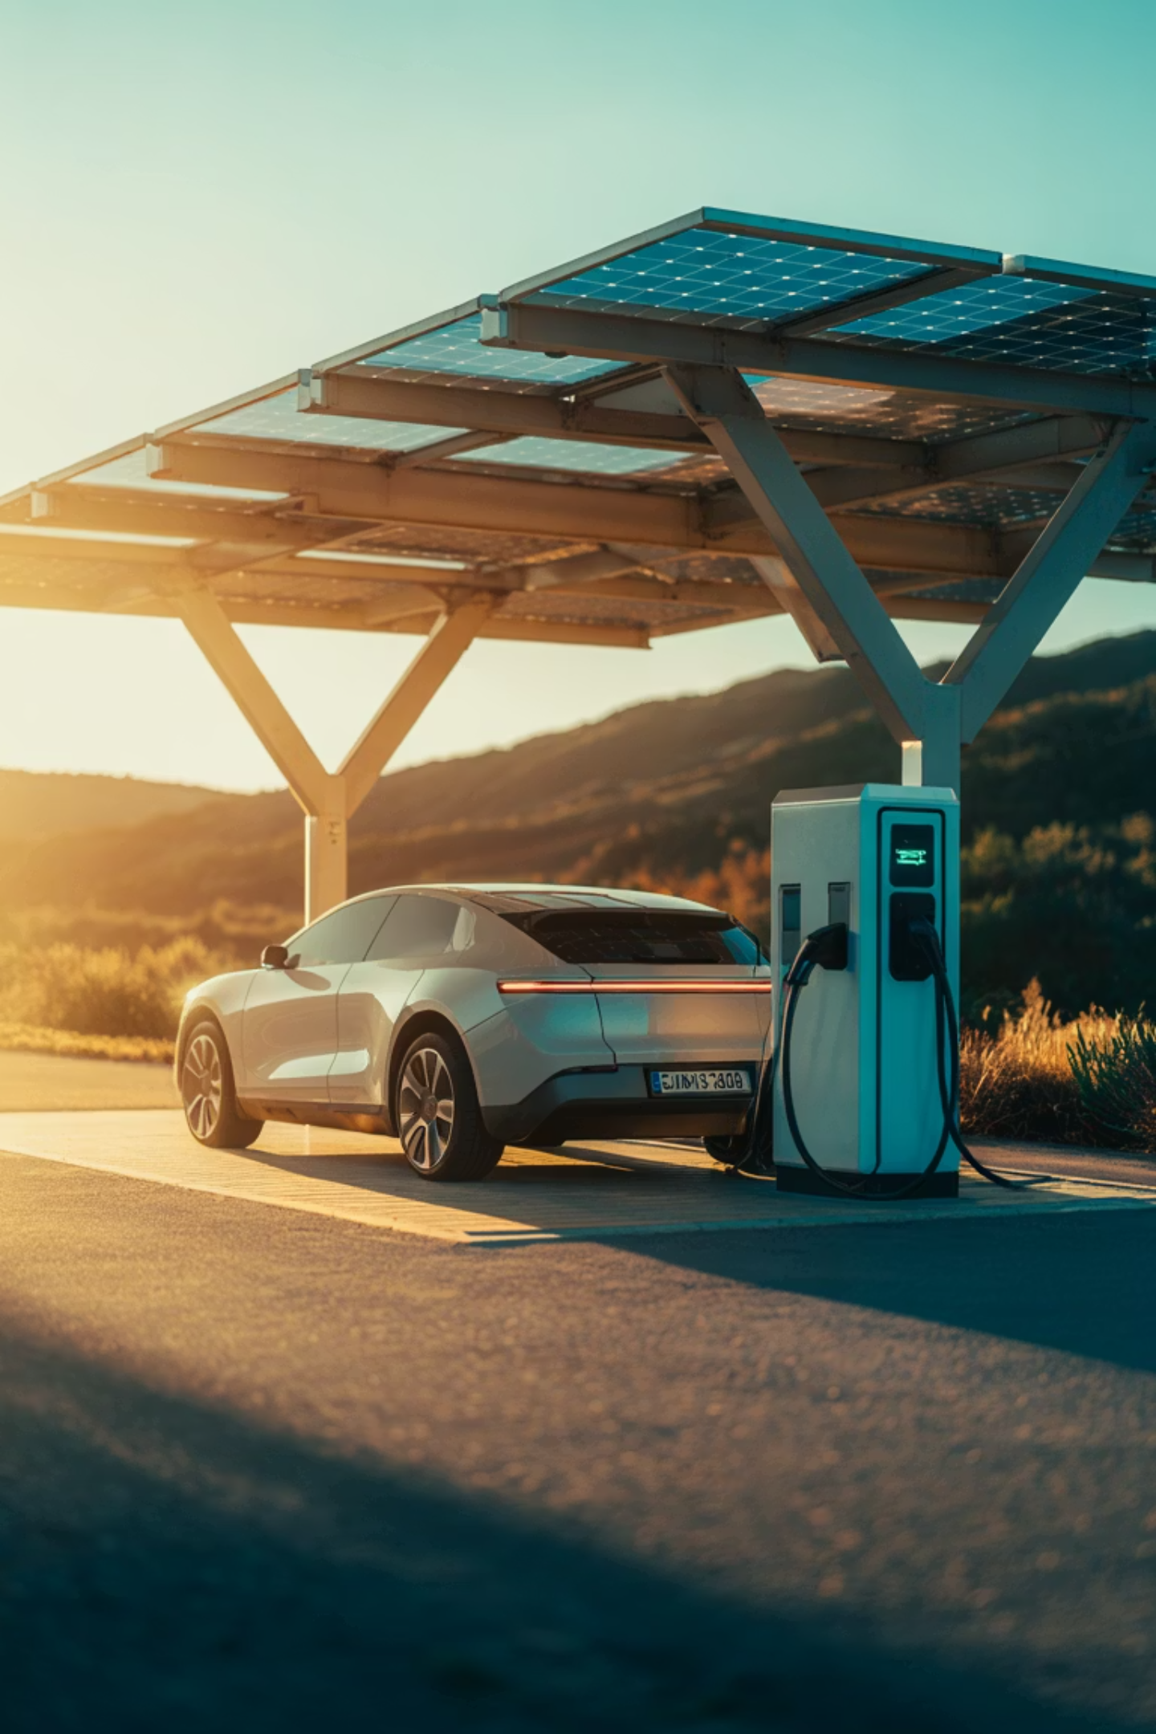
Conclusion & Future Scope
Key Findings
Future Improvements
AI can predict charging demand accurately
Smart scheduling reduces wait times
Predictive maintenance saves money
Integrate with smart grid systems
Add real-time traffic data
Include renewable energy sources
"In conclusion, AI solves major EV charging problems. Future work should connect to smart grids, add traffic data, and incorporate renewable energy. This research paves the way for smarter, sustainable transportation."

